Slide 1
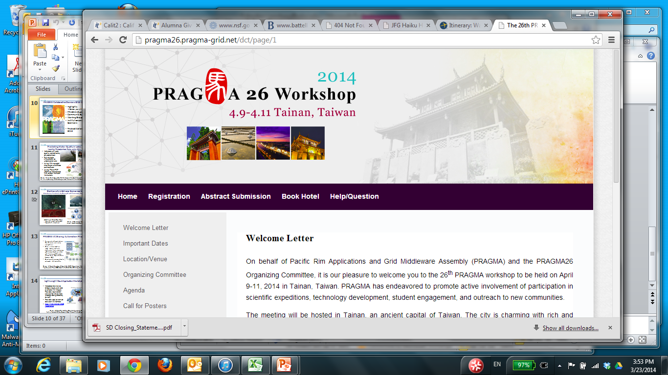

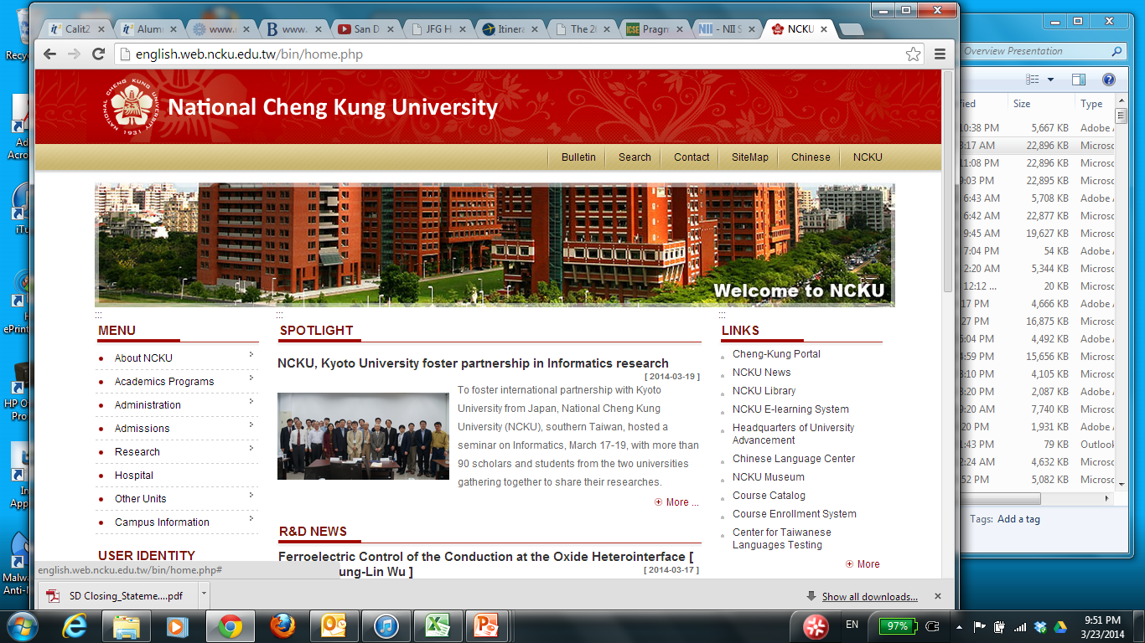
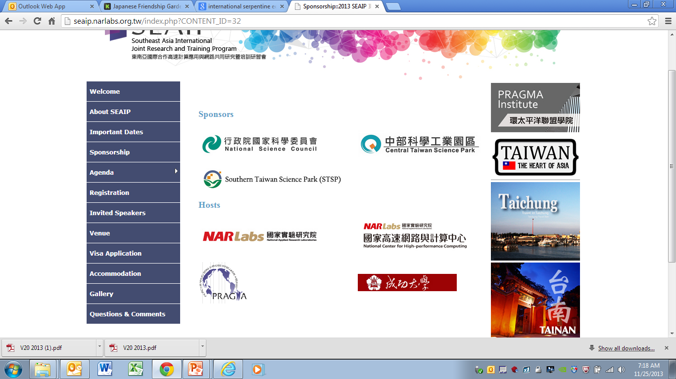
Overview of PRAGMA Progress Since PRAGMA 25
2014 April 10
National Center for High-performance Computing

Slide 2
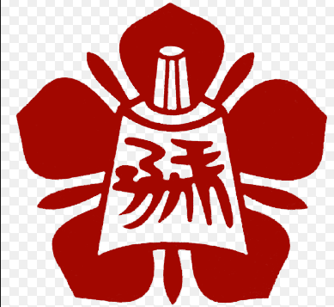
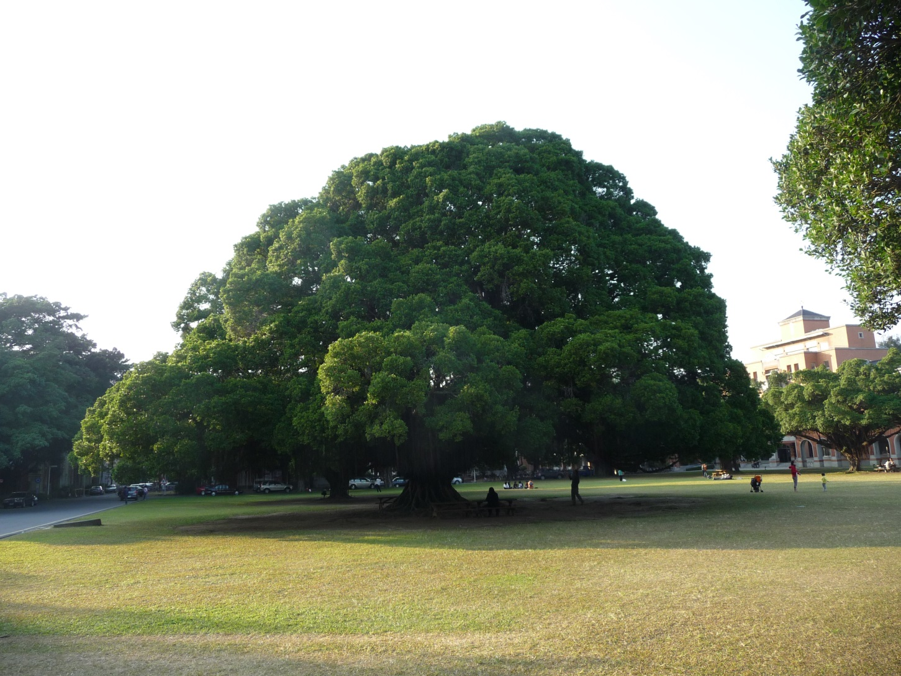
National Cheng Kung University
Banyan Tree

Slide 3
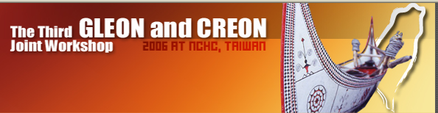

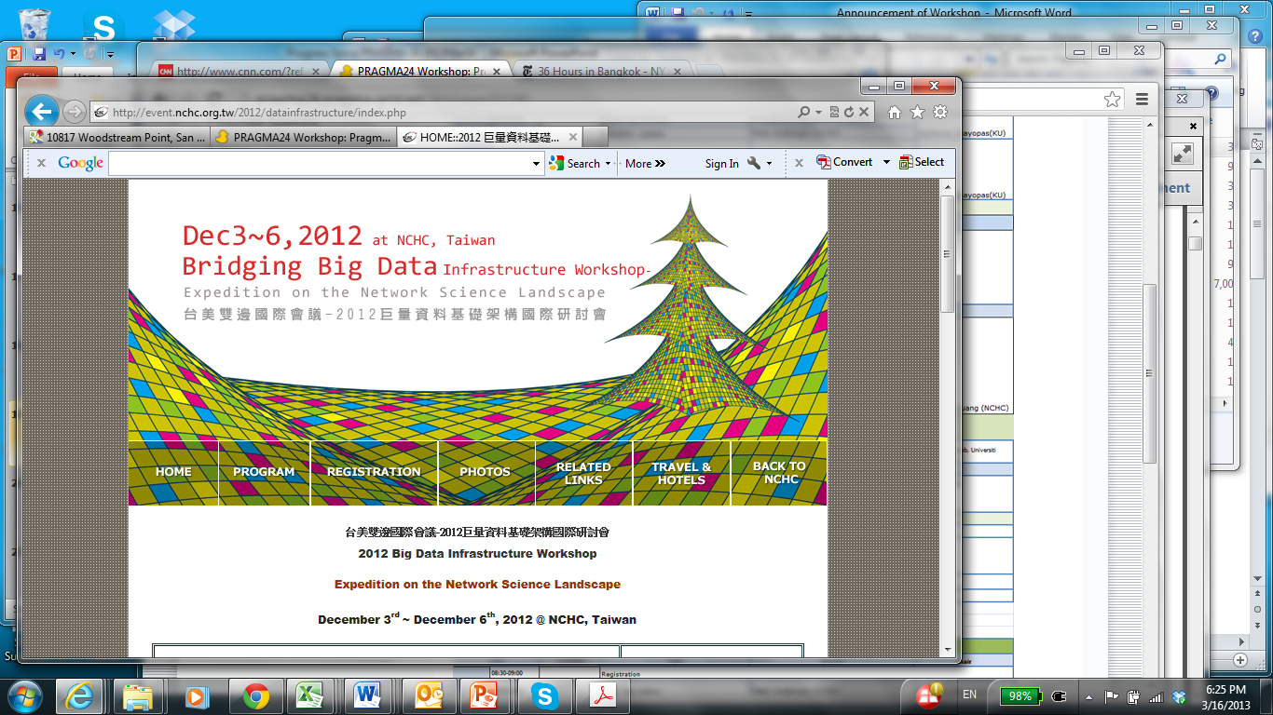
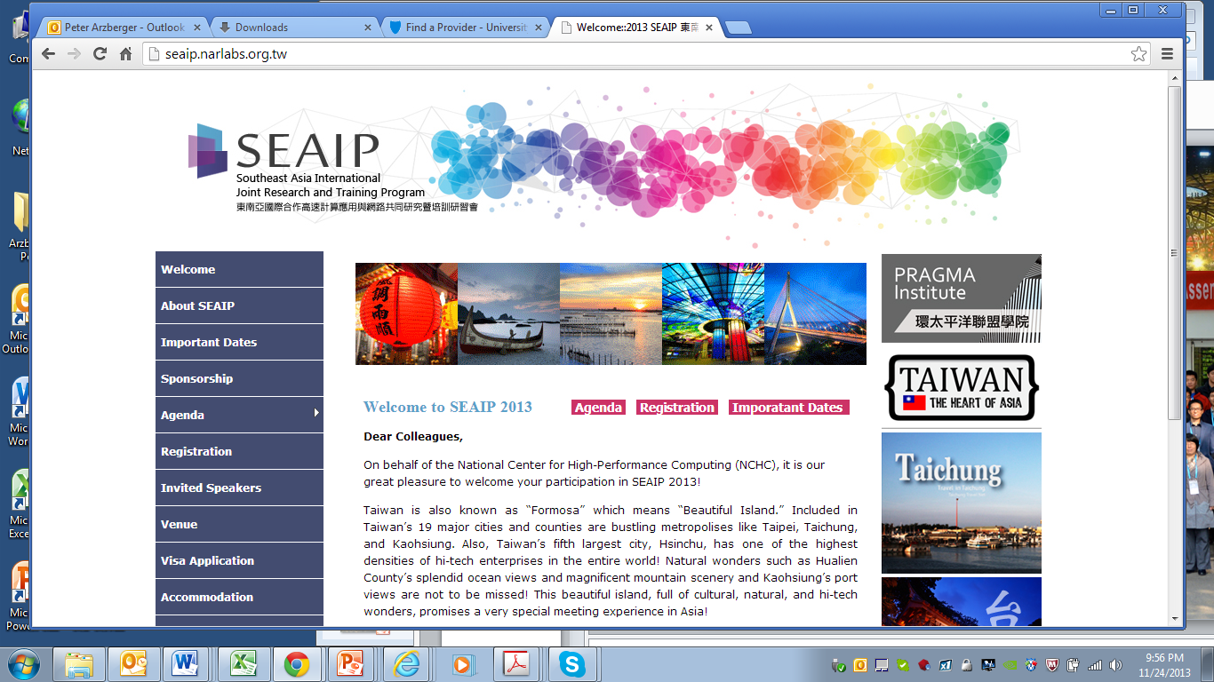
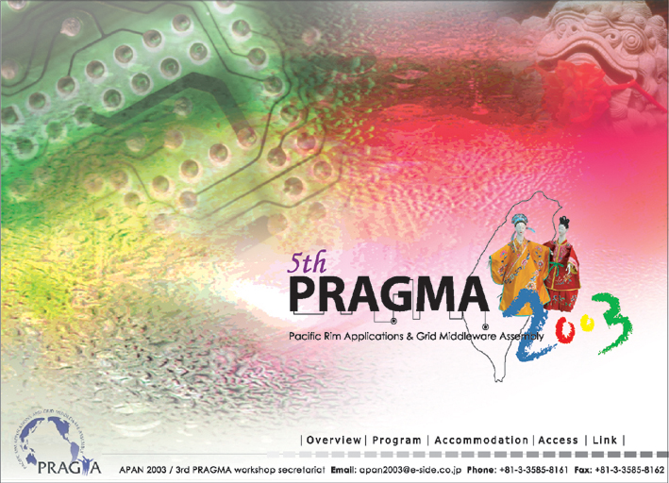
Key Moments in PRAGMA Hosted by NCHC
PRAGMA 5
22 – 23 October 2003, Hsinchu
Trip that Started GLEON
PRAGMA 14
11 – 12 March 2008, Taichung
With CREON
PRAGMA 26
9 – 11 April 2014, Tainan
GLEON 3
2-4 October 2006, Hsinchu
SEAIP and PRAGMA Institutes
Big Data
December 2012

Slide 4
The Logo Story
馬
Chinese Character Horse
Pronounced “ma”
(third tone)
Notes:
Karen and our graphic team came up the idea and created the logo (FPLin, 28Feb2014)

Slide 5
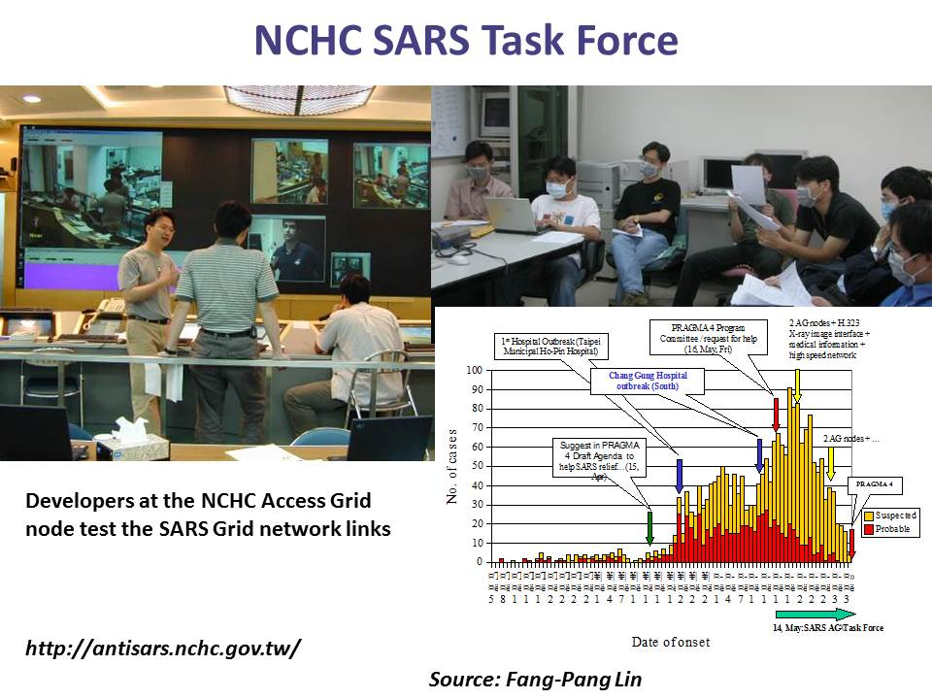
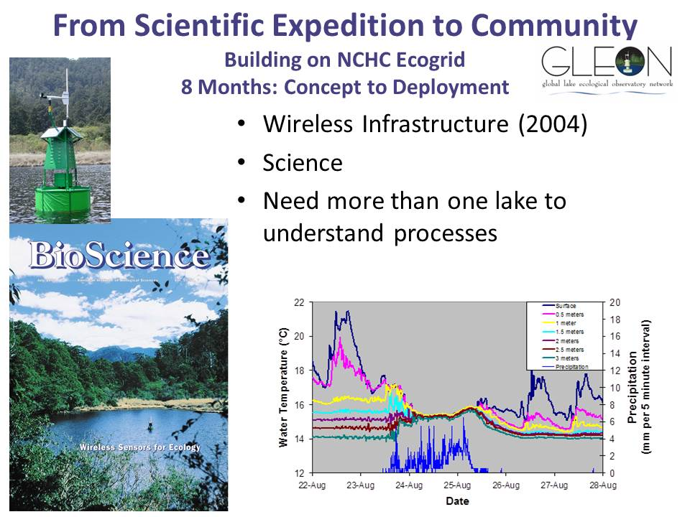
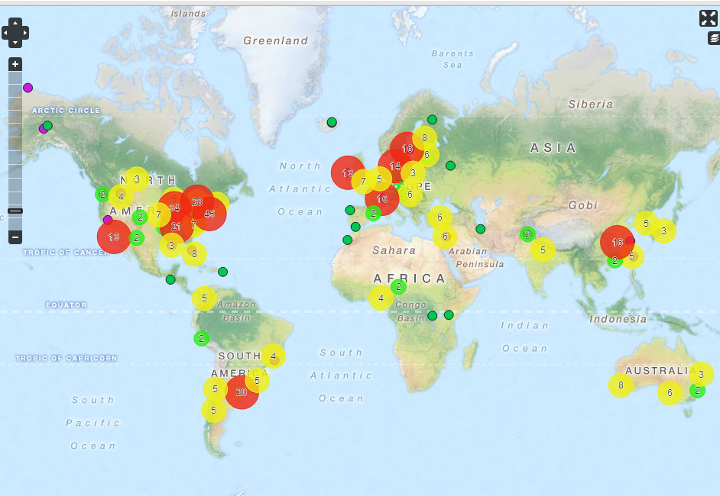
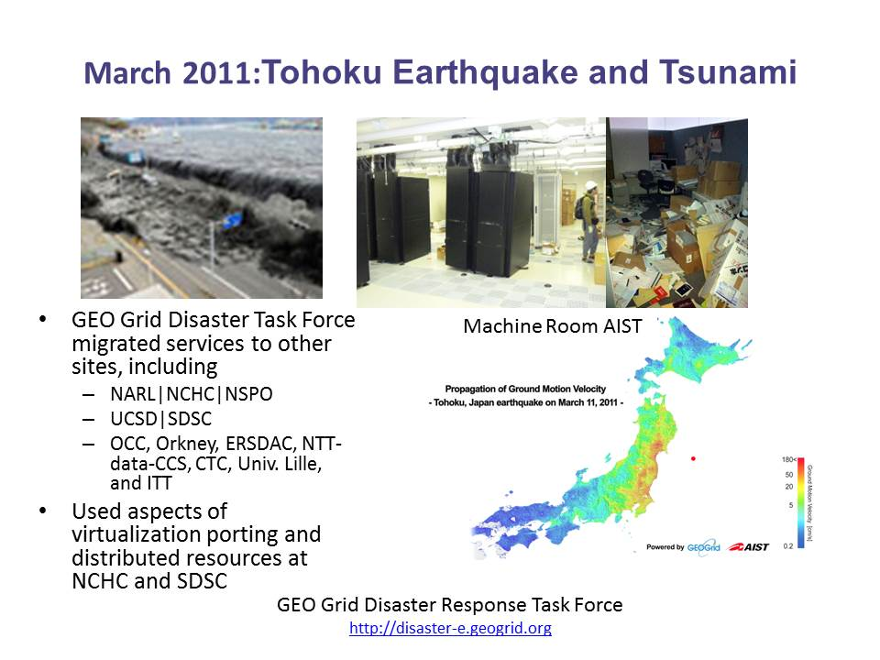
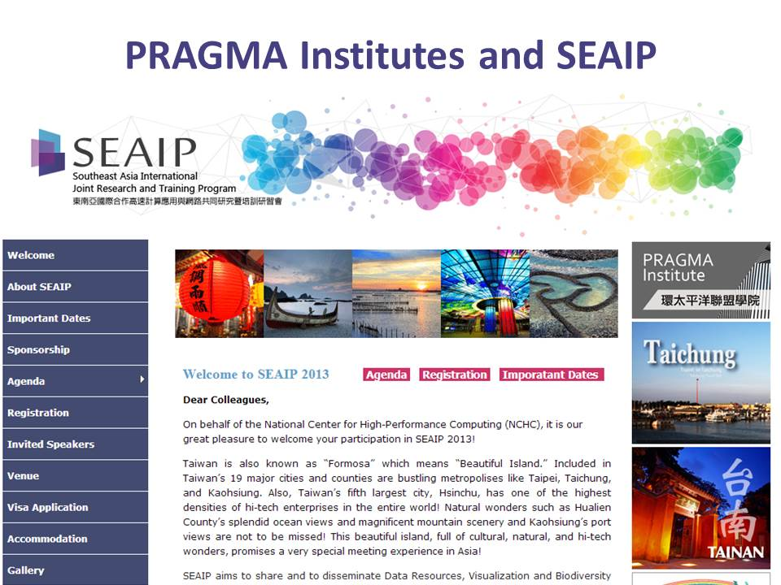
NCHC Contributions to PRAGMA
TFRI

Slide 6
Enabling the Long-Tail of Science through Scientific Expeditions and Infrastructure Experiments for Pacific Rim Institutions and Researchers
PRAGMA
Members
and
Affiliates
Notes:
For individuals new to a PRAGMA workshop – welcome!
As science becomes more distributed and collaborative, there are small to medium sized groups, distributed, that want to work together. PRAGMA is about enabling this long tail of science, through scientific expeditions and infrastructure experiments.
We have always focused on the Pacific Rim. You can see the institutions involved. This includes the four new sites that were accepted as members at PRAGMA 24

Slide 7
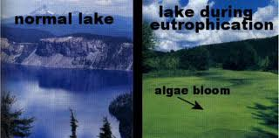
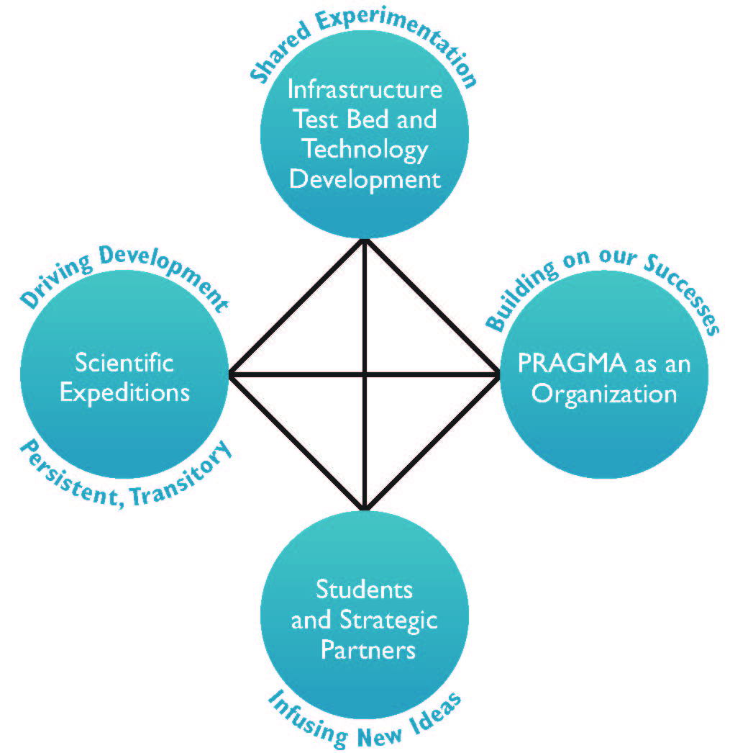
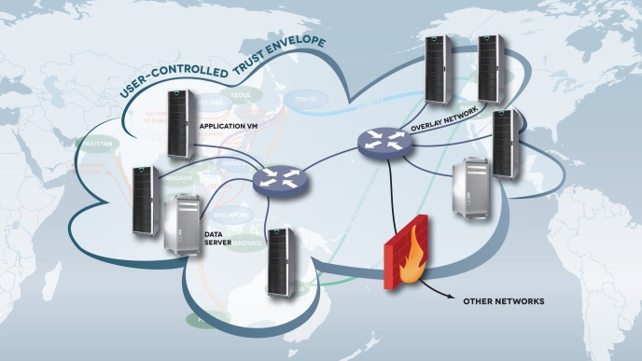
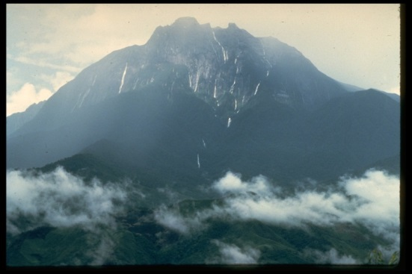

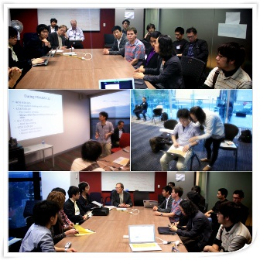
Enabling the Long Tail of Team Science
Virtual Scientific Expeditions
Trust Envelop
PRAGMA Students
PRAGMA Member Sites
PRAGMA Community
Notes:
If I had one slide to sum up PRAGMA’s activity – this might be it
- Driven by applications (upper left). We have selected two so far, but there are many others. We hope that this meeting will develop others.
- Driving toward a Trust envelop by application needs. This trust envelop has many components
- Ability to facilitate interactions and share resources among sites
- Ability to limit that share in a secure way
- Virtualization of software and networks
- Engaging students (lower right). As with any community – we must look to the future. Students and new members are ways we choose to do that
- community based (lower right) … you can see our member sites and read about what we collectively have accomplished
- this is who we are – enabling the long tail of (team) science – by the long tail of science we are looking at groups that want to work together but do not have large, centralized or coordinated funding streams. However, there is desire to collaborate
Mini-PRAGMA in Indonesia
http://minipragma.cs.ui.ac.id/

Slide 8
PRAGMA 26 Progress since PRAGMA 25

Slide 9
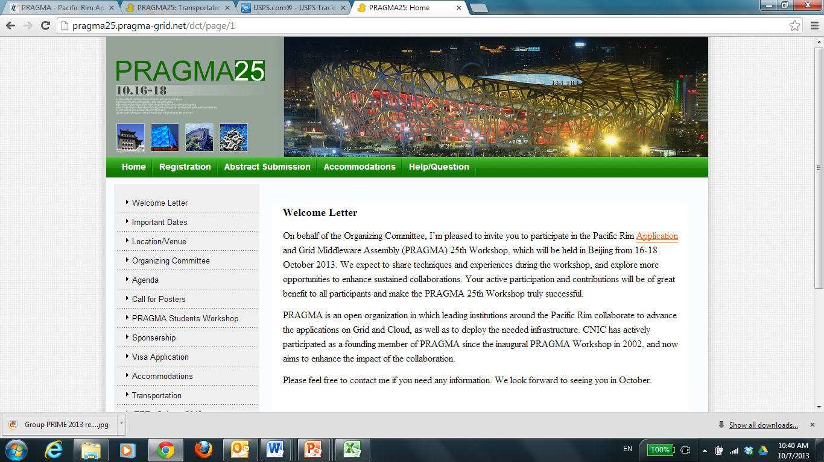
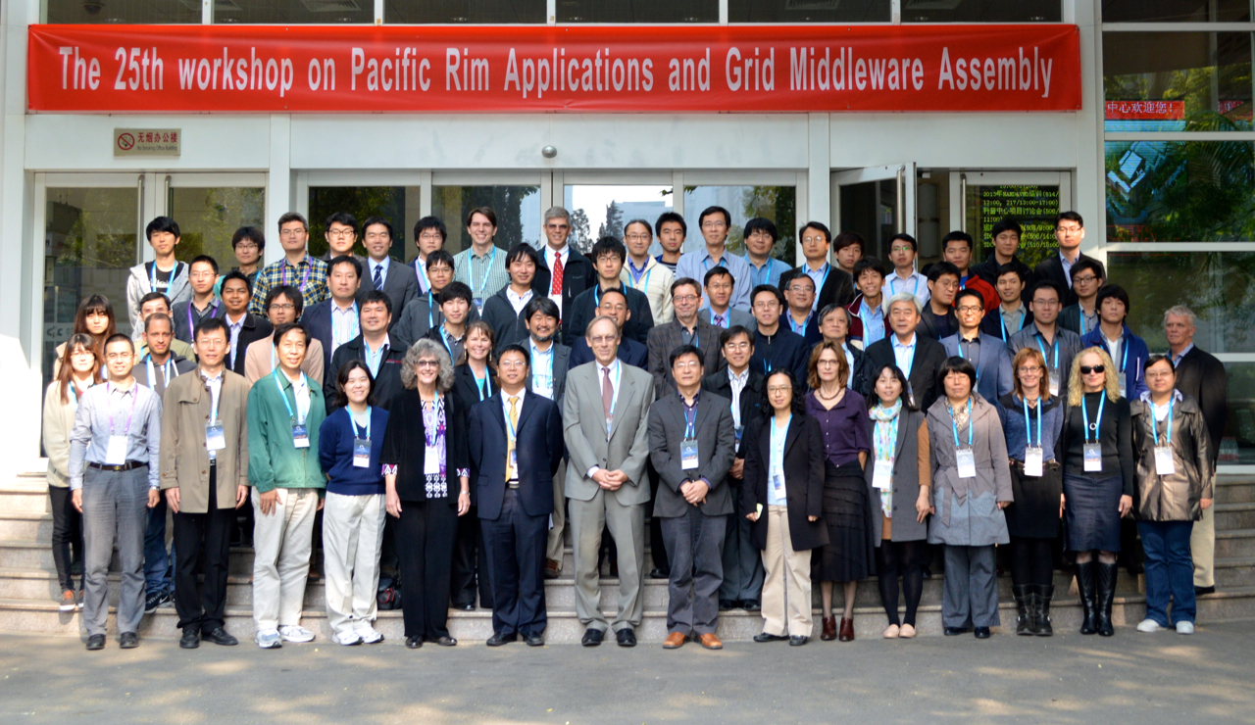
Progress Since PRAGMA 25 Host CNIC 2013 October 16 - 18

Slide 10

Biodiversity in Extreme Environments Distribution Prediction by Sharing CI and Provenance Capture
Approach: Improve Lifemapper (LM)
Demo: Aimee Stewart, Nadya Williams
Extend previous LM work to enable data management and web services components virtualization
Increase the availability and flexibility of LM to enable scientists to
Assemble multi-species macro-ecology experiments
Perform other LM-facilitated data processing on:
Unique datasets; Restricted use data
Very large datasets

Slide 11
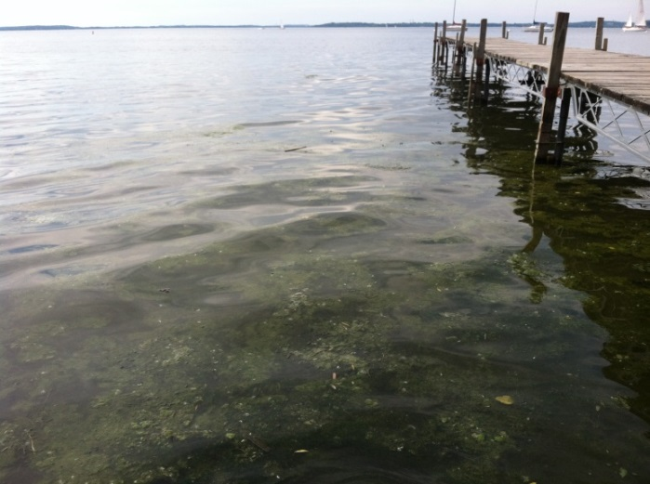
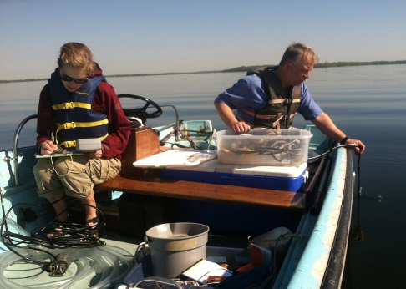
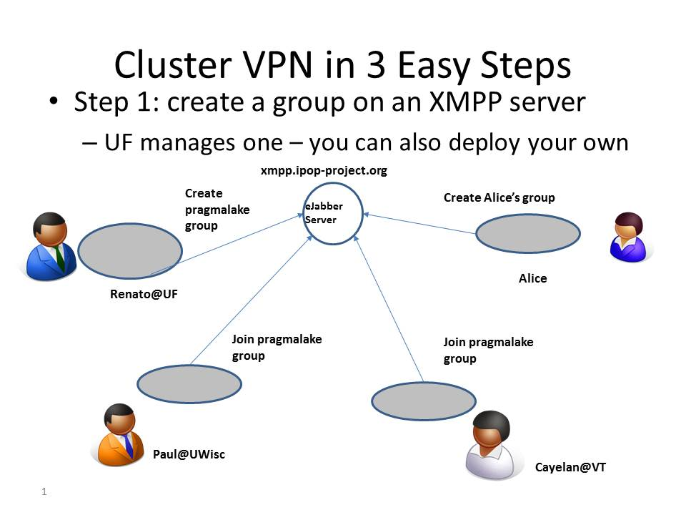

Predicting Water Quality in Lakes Developing Predictive Models using IPOP Overlay
Lake eutrophication is global issue, results in degraded water quality
Calibrate new hydro-dynamic model, check model against data
Using IP-over-P2P (IPOP) to interconnect resources (and VMs) across multiple institutions, creating “trust envelope”
Collecting light,
temperature data
Demo: Paul Hanson, Craig Snortheim, Luke Winslow (U. Wisconsin),
Cayelan Carey (Virginia Tech); Renato Figueiredo, Pierre St. Juste, Ken Subratie (U. Florida)
Notes:
Phytoplankton – microalgae
Photos:
Upper Right: Paul Hanson (U Wisc), Cayelan Carey (Virginia Tech) @ GLEON 'Spring Blitz'- I especially like the one of Paul lowering the light meter over the boat while I record the temperature profile! It is good to remind people that sometimes you really have to get out and do some data collection, as input into computational models.
Upper Middle: Phytoplanton visible on Lake Mendota (Center for Limnology dock, UW, Madison) – this is what the team is trying to understand – namely the rules to govern phytoplanton growth.
Figure: IPOP (Jose, you will know how to explain this).

Slide 12
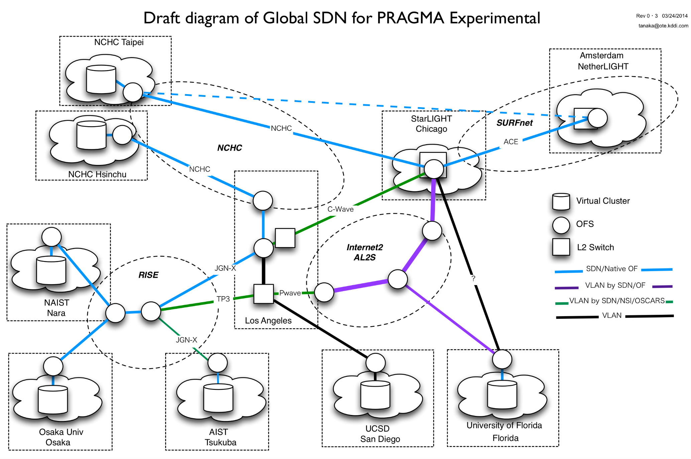
PRAGMA Experimental Network Testbed (ENT) Mauricio Tsugawa; Kohei Ichikawa
L2 Network - Draft (by Jin Tanaka)
Started PRAGMA 25
Other Participants
- KDDI
- CNIC
- Jilin U
- Kasetsart U

Slide 13
Updates via Demos and Working Groups
Seamless Aggregation of Computing Resources for Lake Modeling with Overlay Virtual Networks
Paul Hanson, Luke Winslow (U. Wisconsin), Cayelan Carey (Virginia Tech); Renato Figueiredo, Pierre St. Juste, Ken Subratie (U. Florida)
Global Virtual Cluster Deployment through a Content Delivery Network
Pongsakorn U-chupala (NAIST); Luca Clementi, Philip Papadopoulos (UCSD), Kohei Ichikawa (NAIST)
A Demo of Ceph Distributed File System over Wide Area Network: Lesson Learned
Mohd Bazli Ab Karim, Ming Tat Wong, Jing Yuan Luke (MIMOS)
Increasing the Lifemapper Availability and Flexibility
Nadya Williams (UCSD), Aimee Stewart (KU)
User-level Controllability of Virtual Clusters using HTCondor
Shava Smallen (UCSD); Yuan Luo, Beth Plale (Indiana U.), Philip Papadopoulos (UCSD)
Real-time Persistent Ocean Monitoring using Open Source DataTurbine (OSDT) Android SensorPod
Peter Shin, Tony Fountain, Sameer Tilak, Thaddeus Trinh (PRIME 2013), Susan Kram, Jennifer Smith (UCSD)
Mobile Devices Help Collect and Stream Data from Ecological Sensor Network into the Cloud
Yu-Huang Wang (TFRI); Tony Fountain, Peter Shin (UCSD); Sheng-Shan Lu, Chau-Chin Lin (TFRI); Sara Taghizadeh (PRIME 2012), Thaddeus Trinh (PRIME 2013) (UCSD)
Challenge: Moving from Demo to Use
Notes:
Pragma Boot -- Pong, Luca
Network Testbed -- Ichikawa, Mauricio (and Luca and Pong)
Personal Cloud Controller (PCC, hey I named it)... Shava, Yuan
iPOP overlay and interaction with Lake Ecology Expedition- Renato
Life Mapper server and other extensions -- Nadya and Aimee

Slide 14
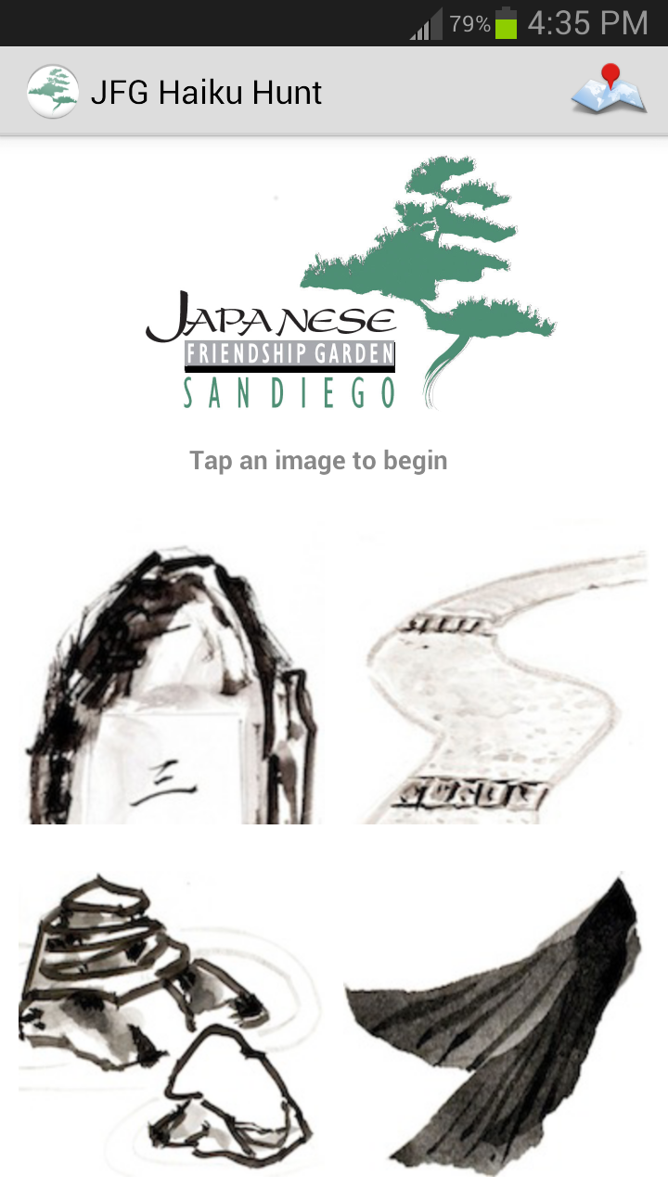
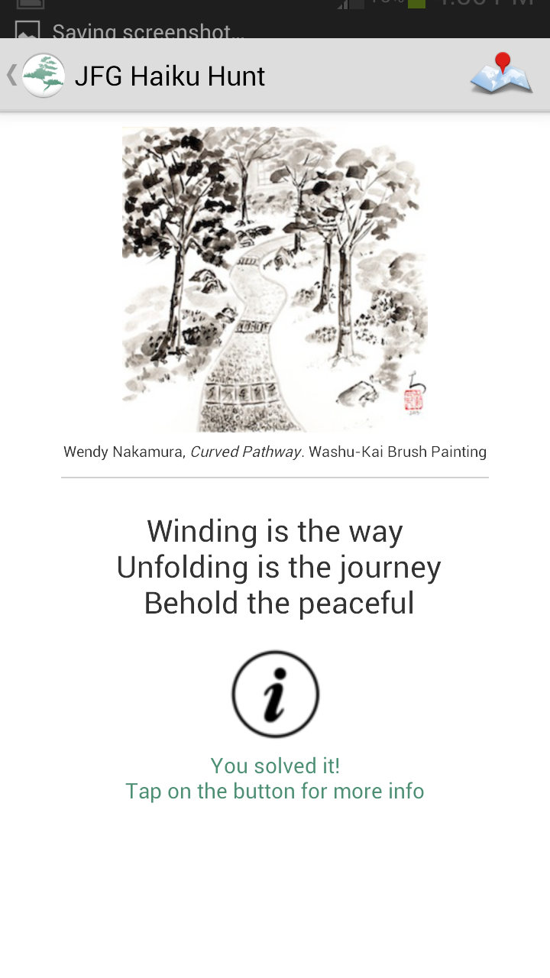
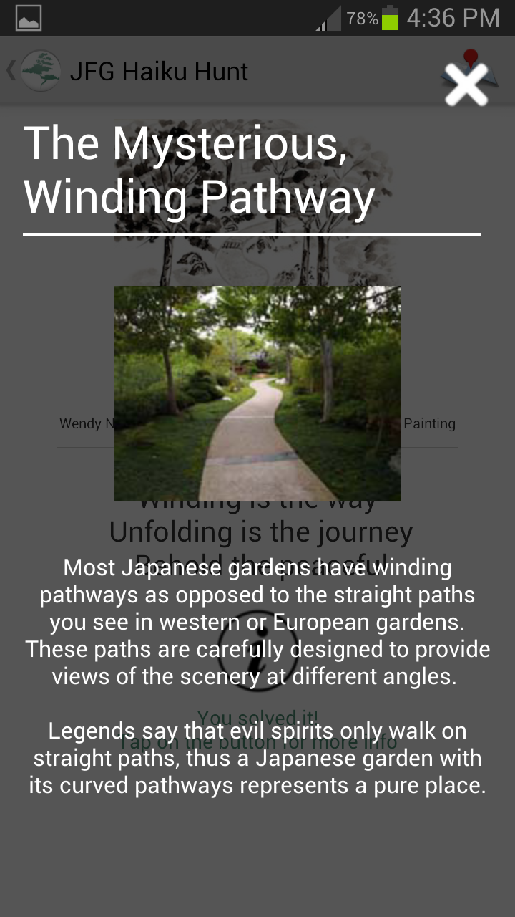
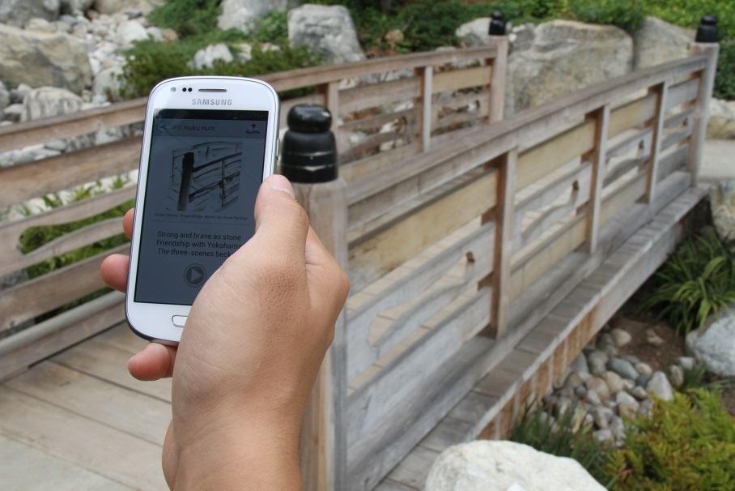
San Kei En Project (Japanese Friendship Garden Haiku Hunt)
Android-based, location-aware mobile application
First outside use of Place Sticker technology to preserve beauty, maintain connectivity
Fun! Haiku! Impact!
Demo: UCSD: Jason Haga, Jesus Rios (PRIME 2013); Osaka U: Shinji Shimojo;
BPOC: Vivian Haga, Wesley Hsu (PRIME 2011); ISID: Kazuhiro Toda;
Ritsumeikan U: Nobuhiko Nishio
Notes:
Top set of three images: screen shots from the application
Screenshots from JFG (Japanese Friendship Garden) android app: main page, solved winding pathway screen, and detailed information screen.
Lower image, at the Japanese Friendship Garden with image on phone of bridge – also in background
KEY POINTS:
- PRIME STUDENT
- Will go live later this month or early next month
- First outside application of technology

Slide 15
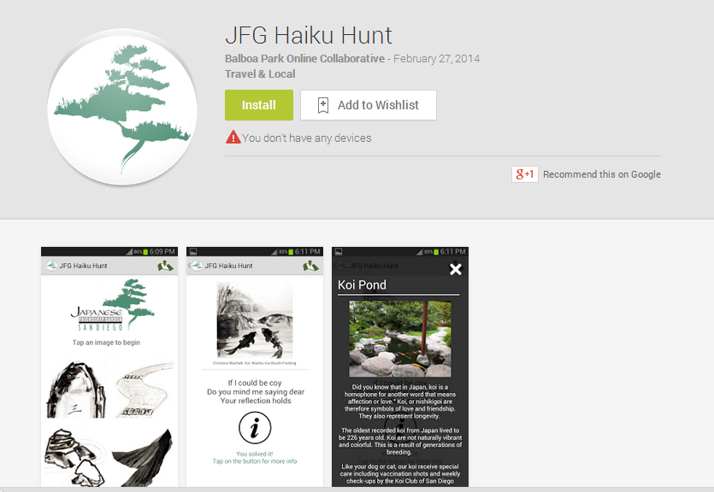
Download at
Google Store
Discuss with Jason Haga (now at AIST) or Shinji Shimojo
https://www.youtube.com/watch?v=Y4bp-yxd9lQ&feature=youtu.be
Notes:
Haiku Hunt Mobile App Launch
Japanese Friendship Garden's Haiku Hunt App at Google Store
Video
https://www.youtube.com/watch?v=Y4bp-yxd9lQ&feature=youtu.be
Demonstration proposal for the JFG Haiku Hunt
Museums and the Web Conference (5 April 2014)
Collaboration with NICT, Balboa Park On-line Collaborative, UCSD, PRIME
Wesley Hsu, PRIME 2011
Jesus Rios, PRIME 2013
Highlighted in PRAGMA Collaborative Overview 2013- 2014

Slide 16

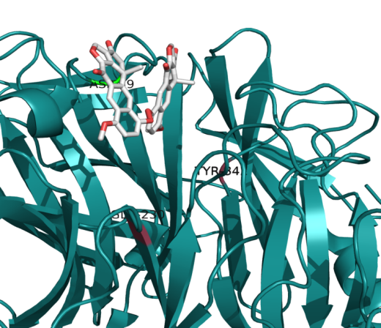
PRIME 2014 11th Year of Program
Students bridge to PRAGMA members
Projects include cardiac modeling, virtualization, virtual screening, cultural heritage, and visualization
Host sites for the 12 students: NICT, NAIST, U Queensland, National Taiwan University, NCHC
Shinji Shimojo, Kohei Ichikawa, Jason Haga, David Abramson, Jung Hsin Lin, Fang Pang Lin
Notes:
The image in the lower right is Dihalenaquinolide A docked to Trans-sialidase (Hanne Wolff – working at National Taiwan University)
Background: The focus is address Chagas disease – caused by a protozoa. Recently there is a focus on developing drugs that attach the protozoa. In particular we are looking at Trans-sialidase (TcTS), found on the membrane of the protozoan. The project looked at natural products in Taiwan to see which might bind and interrupt the protozoa (this is done in computer). One was Dihalenaquinolide A
Project 2: A second student, Ashley He, an electrical engineering student, will be working with UCSD mentor Philip Papadopoulos and the National Center of High-performance Computing mentor Dr. Fang-Pang Lin, in Taiwan, on using Open CV that takes multiple two-dimensional (2D) images and outputs a 3D stereoscopic image accurately in real-time. More details of the project include the following:
Reconstruction of three-dimension (3D) models has become a very important and challenging topic in the field of computer vision due to the variety of applications in computer graphics, visualization, surveillance, etc. The goal of the project is to implement a system using Open CV that takes multiple two-dimensional (2D) images and outputs a 3D stereoscopic image accurately in real-time. This system will also maintain high performance under the constraints of a large-scale data set.

Slide 17
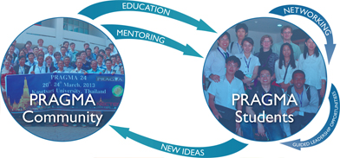
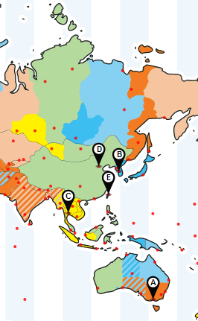
PRAGMA STUDENTS “Make student network, strengthen student research”
Provide Opportunities for Students
Stimulate ideas and activities in PRAGMA
Motivated and assisted by GLEON
Melbourne, Australia PRAGMA 22 Pre-workshop
Seoul, South Korea PRAGMA 23 The 1st student workshop
Bangkok, Thailand PRAGMA 24 The 2nd student workshop
Beijing, China PRAGMA 25 The 3rd student workshop
Tainan, Taiwan PRAGMA 26 Here We Are !

Slide 18
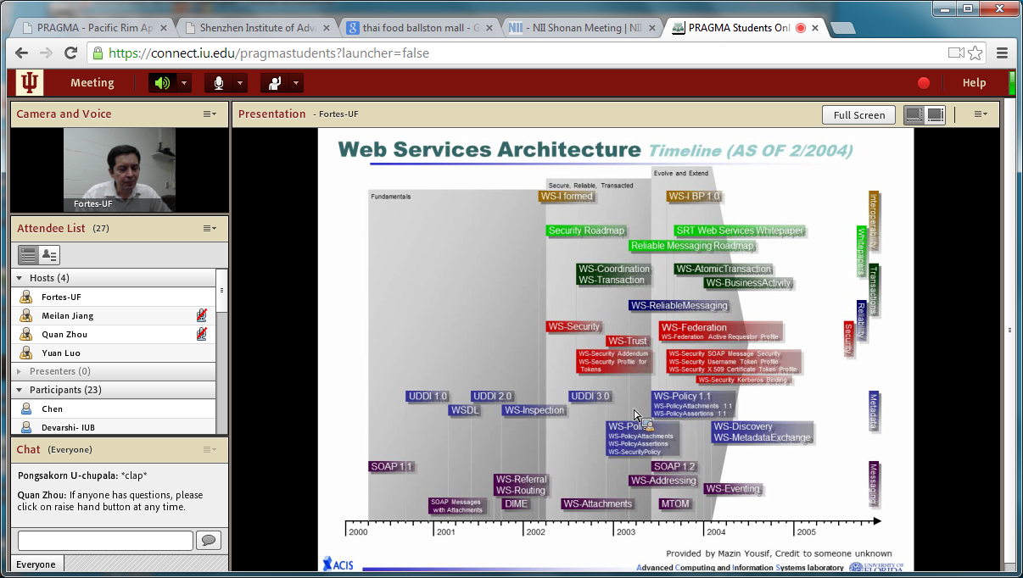
2nd PRAGMA Students Distributed Seminar Towards Distributed Software Defined Systems
https://connect.iu.edu/p5apeig31gn/

Slide 19
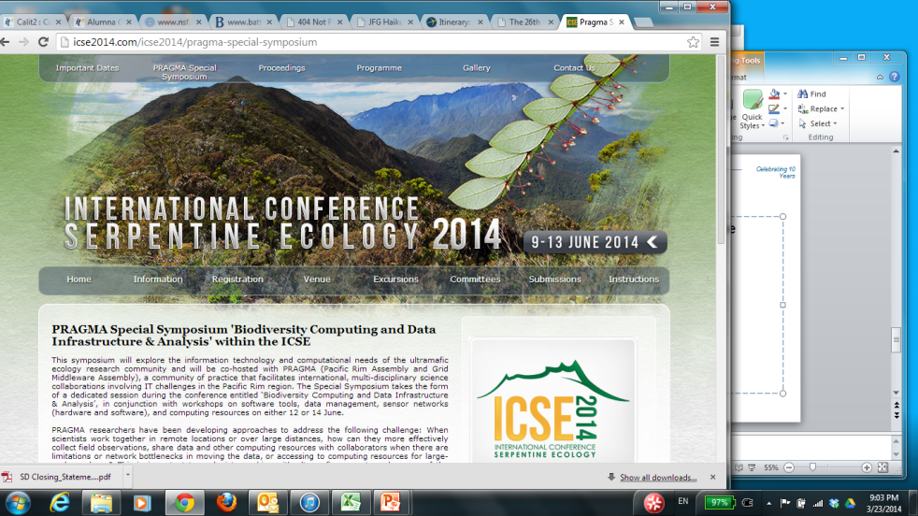
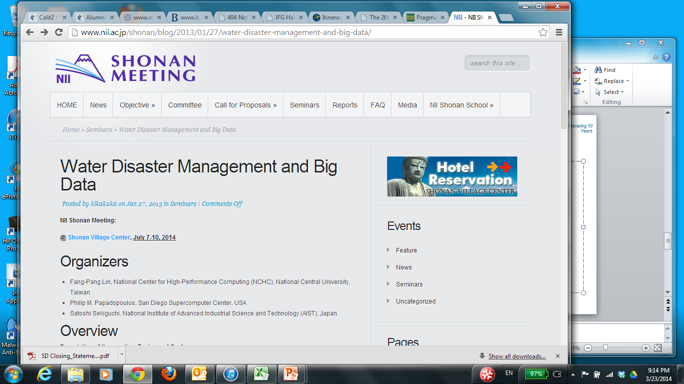
Recent and Future Outreach
Southeast Asia International Joint Research and Education Program
2 – 6 December, Tainan – Host NCHC
A possible outcome: Biodiversity Mobile App (UTM)
International Conference on Serpentine Ecology
9 – 13 June, Kota Kinabalu, Sabah Malaysia
PRAGMA Special Symposium: Reed Beaman (12 June)
Water Disaster Management and Big Data
NII Shonan Meeting, 7 – 10 July 2014
Fang-Pang Lin, Philip Papadopoulos, Satoshi Sekiguchi

Slide 20
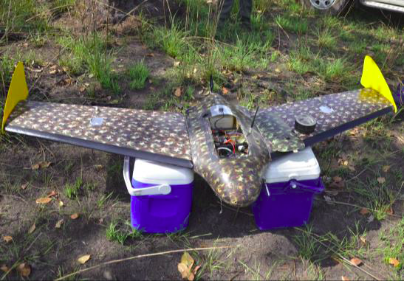
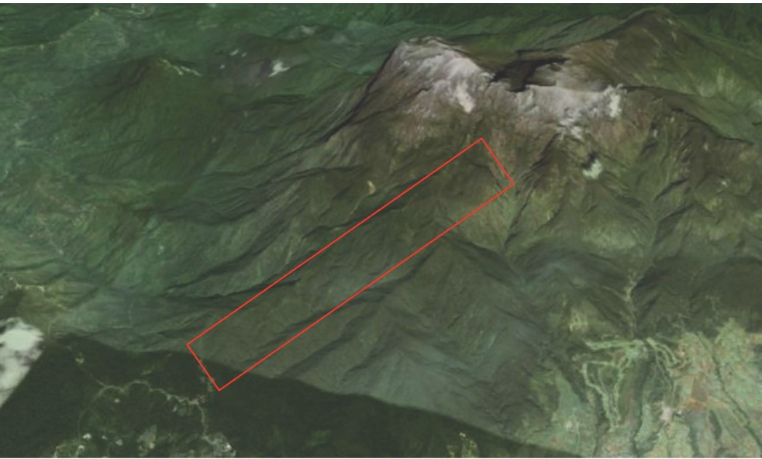
Prior to ICSE Workshop: An Expedition “Capturing ultra-high resolution UAV-imagery in Kinabalu Park”
Pilot-project for modelling vegetation across geological substrates over an altitude gradient in Kinabalu Park
P Erskin, A Fletcher, A v d Ent (U Queensland); Rimi Repin (Sabah Parks); R Beman (U FL); Abdullah Kamaruddan (Minerals and Geoscience Dept)
4 – 8 June 2014
Resolution: 2.3 cm with UAV
2 M wingspan, 4.9 kg
Capture Area 1 (approx 10 km²)
Notes:
The main objective for UAV deployment at Kinabalu Park is to gather ultra-high
resolution imagery over a select area that will be used for modelling of vegetation
across different geological substrates and over an altitudinal gradient (1,550 to 3,800
m asl).
comparison of the best available satellite imagery (Geoeye-50cm and
QB2-240cm resolution imagery with UAV-based imagery at 2.3cm resolution of the
same area of interest.

Slide 21
PRAGMA 26 The Workshop
Experimentation is a part of PRAGMA

Slide 22
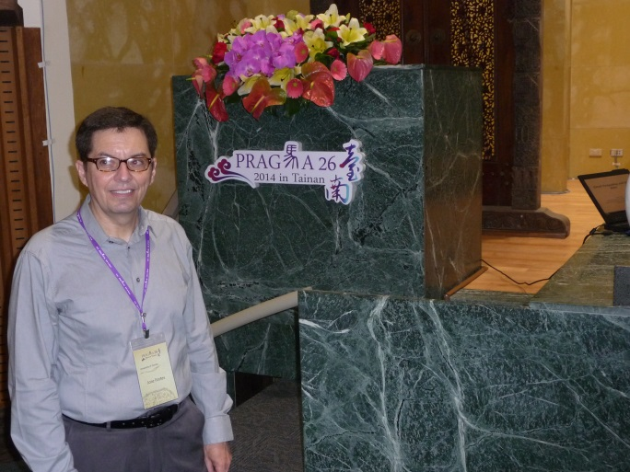
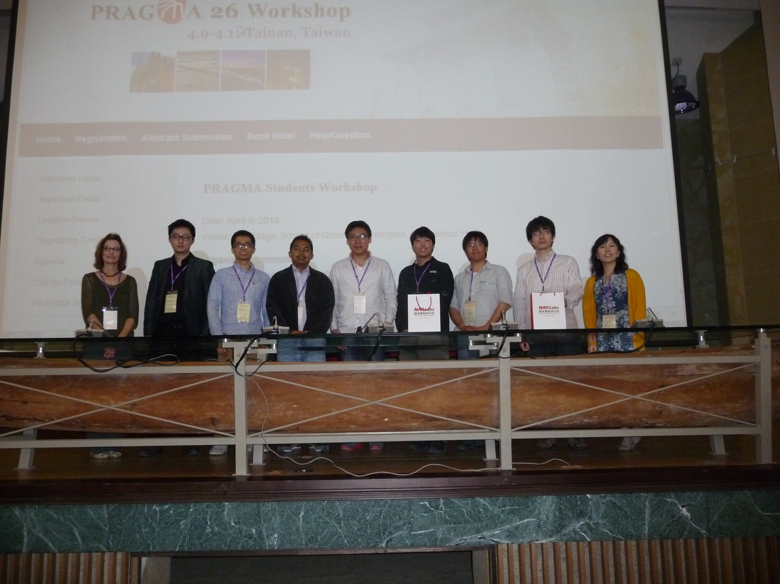
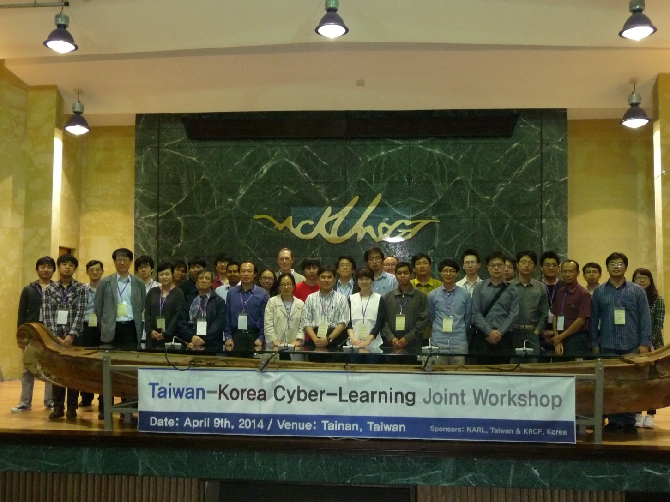
Pre-Workshop Meeting 2014 April 9 Wednesday
Cloud Computing and Big Data
PRAGMA Student Pre-Workshop
Cyber Learning Workshop

Slide 23
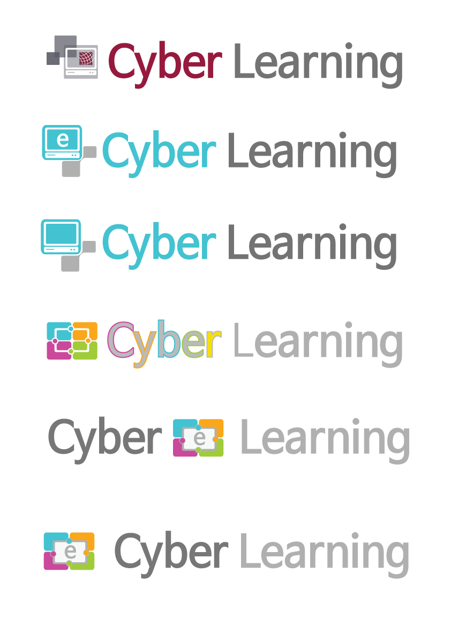
Objectives
Goals
Providing cyber education & research environments in computational science
Utilizing Computing resources & services in PRAGMA community
Promoting developing & utilizing activities through global collaborations
Cyber
Learning WG
Development of Cyber-Learning open platform and education/ research simulation S/W
Establishment of international research communities and connections to higher education
Construction of collaboration channels amongst PRAGMA Community
Activities
Collaborating with Resource/Tele-Science/Bio/Geo Working Groups
Co-developing and sharing of various simulation SWs and contents for Cyber
Learning in PRAGMA Community
Sharing of information and experience on Cyber-Learning in PRAGMA Community
Holding Joint Workshop/Seminar/Contest on Cyber-Learning
Proving Cyber-Learning service to PRAGMA Community through Web Portal
Source: Ruth Lee

Slide 24
Agenda Highlights and Challenges
Cloud Computing, Big Data and Examples
Yi-Ping Lin, Political Deputy Minister, Ministry of Science and Technology, Taiwan
Big Data Panel
What should PRAGMA be doing in (Big) Data?
Students Panel
Best Lightening Talks
Panel to Discuss Talks
Challenge for all of us: Engage students in research, utilize PRAGMA expertise and resources, build stronger collaborations
Demos of Progress
What has been accomplished and can be shared?
Working Group Restructuring and Challenges
What resources (physical, software, data) do you need to accomplish your goals?
What should PRAGMA technologists focus on to help you?

Slide 25
New Format for Working Groups An Experiment
Resources, Networking and Data
Philip Papadopoulos, Yoshio Tanaka, Beth Plale
Telescience / Remote Sensing
Shinji Shimojo, Fang-Pang Lin, Sornthep Vannarat
Scientific Expeditions
Reed Beaman, Paul Hanson, Chao-Chin Lin
Identify challenges to achieve scientific goals! And provide perceptions of how the rest of PRAGMA might be able to help!
Cyber-learning / Distance Education
Ruth Lee, Shyh-Ching Lin

Slide 26
Steering Committee Topics
New Leadership
On the Steering Committee
Leading Projects and sub working groups
Data Infrastructure and Direction for PRAGMA
What are the possible next steps after the panel?
Shonan Meeting: Goals and Discussion
Water Disaster Management and Big Data

Slide 27
Living with Big Data
Opportunities in a Broader Context

Slide 28
“Big data" refers to data that challenge existing methods due to
size, complexity, or rate of availability. (Jan 2014)
Notes:
NSF solicitation on Big data

Slide 29
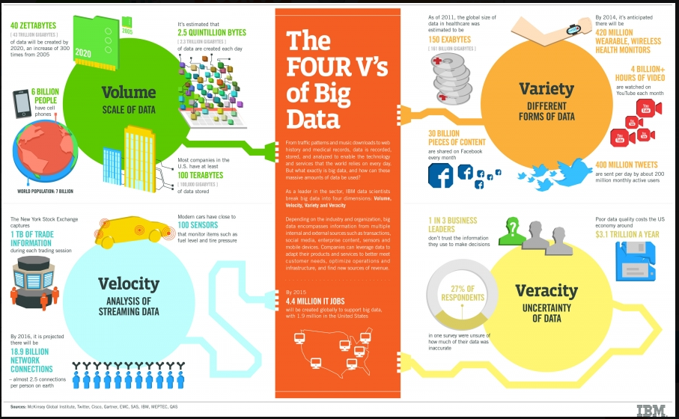
The VVVV of Big Data
S
Source: Jose Fortes

Slide 30
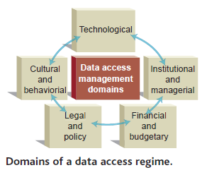
Big Data: More than Technology
Technological: Infrastructure, Interoperability, Quality Control, …
Institutional and managerial: Flexibility across communities
Financial and budgetary: Long-term curation access
Legal and policy: National and international laws need to be mindful of publically funded data
Cultural and behavioral: Reward structure to promote access and sharing
Image: Science 19Mar2004
Value in the data are in their use
Notes:
There are five broad groups of issues that stand out in any examination of research data access and sharing regimes. The Follow Up Group used these as an analytical framework for examining the case studies that informed this report, and in doing so, came to several broad conclusions:
• Technological issues: Broad access to research data, and their optimum exploitation, requires appropriately designed technological infrastructure, broad international agreement on interoperability, and effective data quality controls;
• Institutional and managerial issues: While the core open access principle applies to all science communities, the diversity of the scientific enterprise suggests that a variety of institutional models and tailored data management approaches are most effective in meeting the needs of researchers;
• Financial and budgetary issues: Scientific data infrastructure requires continued, and dedicated, budgetary planning and appropriate financial support. The use of research data cannot be maximized if access, management, and preservation costs are an add-on or after-thought in research projects;
• Legal and policy issues: National laws and international agreements directly affect data access and sharing practices, despite the fact that they are often adopted without due consideration of the impact on the sharing of publicly funded research data;
• Cultural and behavioural issues: Appropriate reward structures are a necessary component for promoting data access and sharing practices. These apply to both those who produce and those who manage research data.

Slide 31

Research Data Alliance (RDA) Research Data Sharing without Borders
RDA builds the social and technical bridges that enable open sharing of data.
Vision: researchers and innovators openly sharing data across technologies, disciplines, and countries to address the grand challenges of society
Working and Interest Groups: Data Citation, Metadata Standards, Big Data Analytics, Biodiversity Data
More information
https://rd-alliance.org/
Beth Plale, RDA Steering Group and Technical Advisory Board

Slide 32
What is the Value of International Collaborations?
Strengthens ideas – by competing in the global market place
Addresses important problems - which transcend national boundaries, and can only be addressed by international collaborations
Taps into other resources, including expertise
Leveraging Resources (return on investment)
Engages next generation of students
Disseminates ideas and software … rapidly
Heightens impact of work
Is fun

Slide 33
Collaborating with People Like Me: Ethnic Co-Authorships within the US Richard B. Freeman, Wei Huang
Examines 1.5 million scientific papers written solely in the US from 1985 to 2008
During this period, proportion of US-based authors with English and European names fell while the proportion of US-based authors with names from China and other developing countries increased
Evidence shows that persons of similar ethnicity co- author together more frequently than can be explained by chance given their proportions in the population of authors
This homophily in research collaborations is associated with weaker scientific contributions
Papers with more authors in more locations and with longer lists of references tend to be published in relatively high impact journals and to receive more citations than other papers
Diversity in inputs into papers leads to greater contributions to science, as measured by impact factors and citations
National Bureau of Economic Research (NBER )Working Paper No. 19905 February 2014
Notes:
This study examines the ethnic identify of the authors of over 1.5 million scientific papers written
solely in the US from 1985 to 2008. In this period the proportion of US-based authors with English
and European names fell while the proportion of US-based authors with names from China and other
developing countries increased. The evidence shows that persons of similar ethnicity co- author together
more frequently than can be explained by chance given their proportions in the population of authors.
This homophily in research collaborations is associated with weaker scientific contributions. Researchers
with weaker past publication records are more likely to write with members of ethnicity than other
researchers. Papers with greater homophily tend to be published in lower impact journals and to receive
fewer citations than others, even holding fixed the previous publishing performance of the authors.
Going beyond ethnic homophily, we find that papers with more authors in more locations and with
longer lists of references tend to be published in relatively high impact journals and to receive more
citations than other papers. These findings and those on homophily suggest that diversity in inputs
into papers leads to greater contributions to science, as measured by impact factors and citations.

Slide 34
If you want to travel fast, travel alone; if you want to travel far, travel together
African Proverb
Living with Big Data
Requires International Collaboration
By working together, we can go a long way
Notes:
The Mentor’s Guid, Lois Zachary, 2nd edition

Slide 35
Thank You PRAGMA 26 Organizers and PRAGMA 26 Participants

